Slide 1

In Search of Alpha
By: Marvin Halili and Fahad Datoo

Slide 2
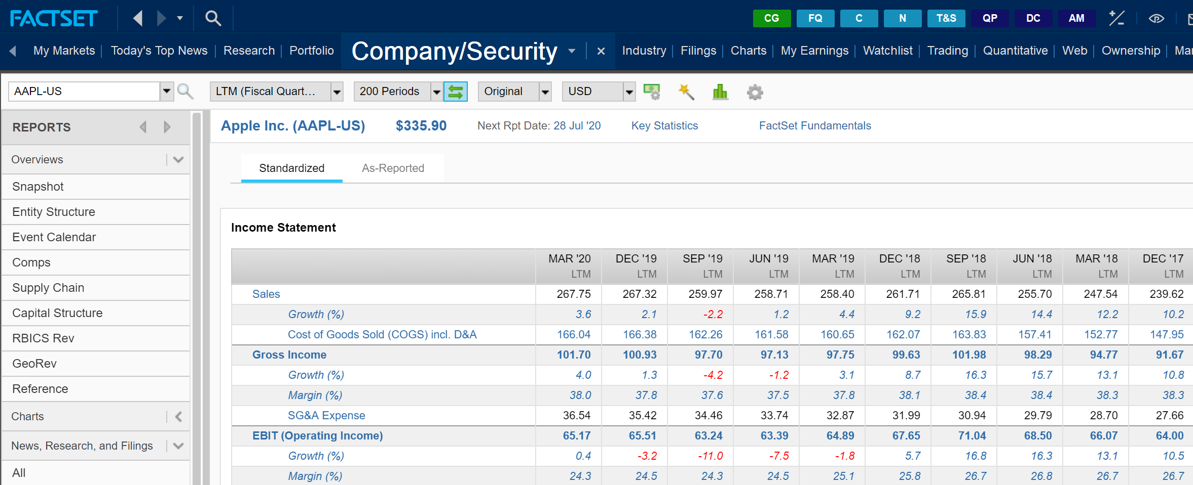
Introduction
How to process and visualize large amount of stock data- including both stock prices and fundamental data.

Slide 3
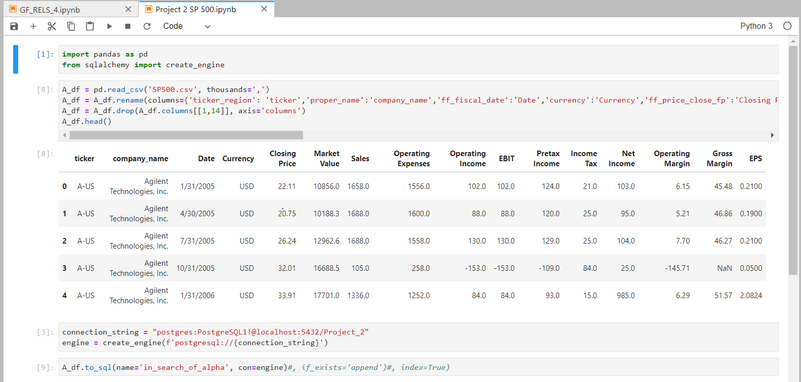
The Challenge & Solution

Slide 4
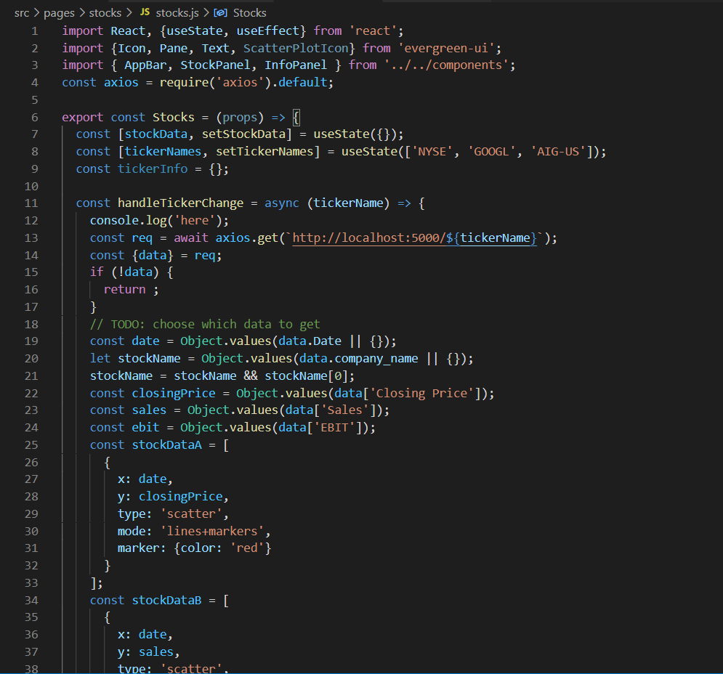
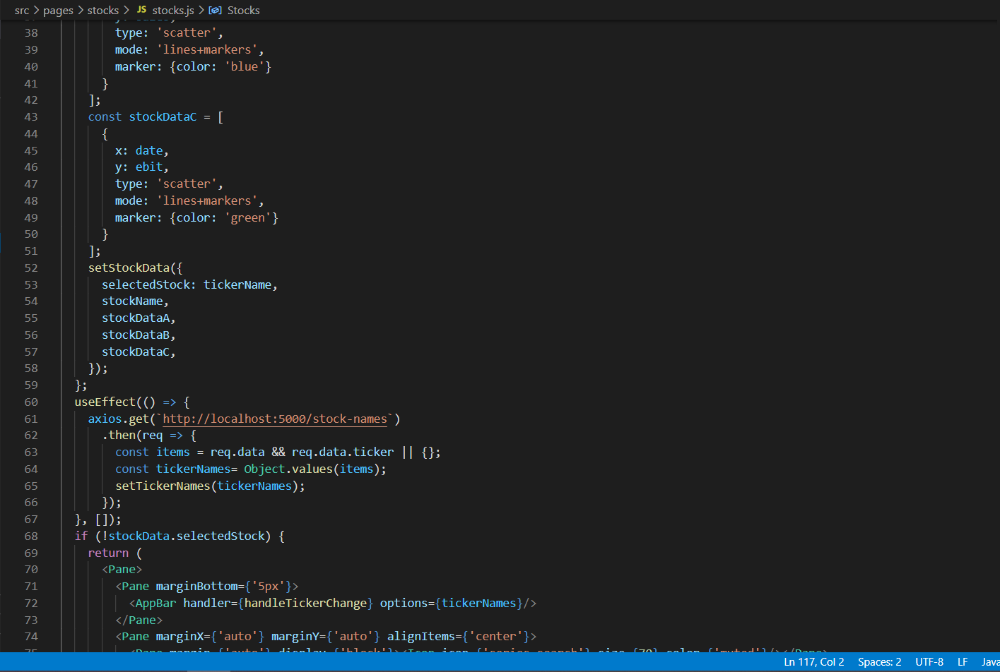
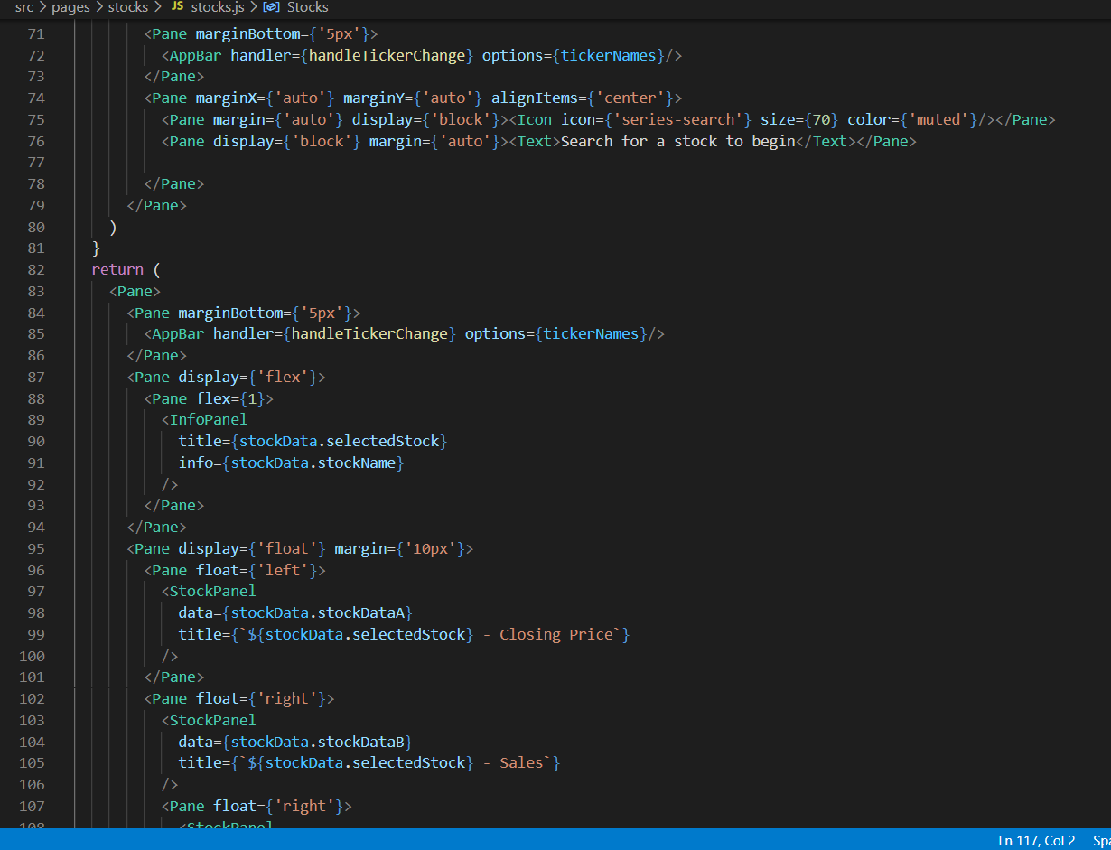
The Challenge & Solution

Slide 5
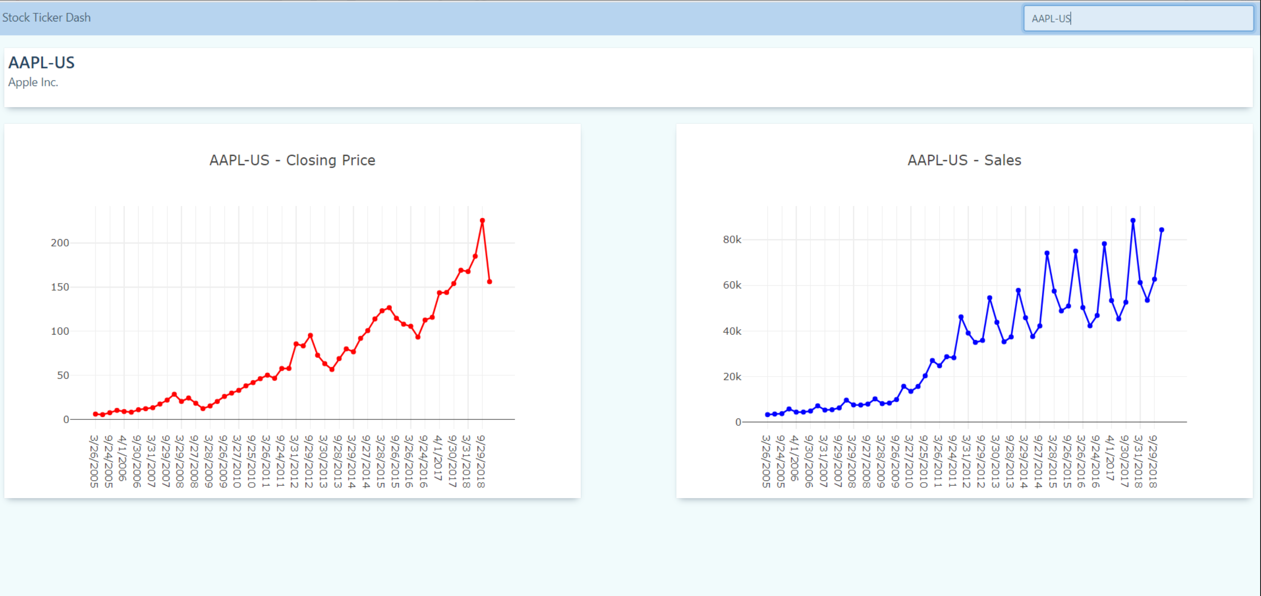
The Challenge & Solution

Slide 6
Additional Application of the Dashboard
The ease of use and interactive nature of Javascript, allow all members of our team to use this dashboard.
We are also quite excited that we can use this dashboard to present to both existing and prospective clients.

